Slide 1
Sentiment analysis of restaurant reviews
GIRISH KUMAR RAMACHANDRA 89girishkumar@csu.Fullerton.edu
888253630

Slide 2
Agenda
My motivation
Project Description
System Design Methodologies
Demo
Conclusion
Significance
Implications and Future scope

Slide 3
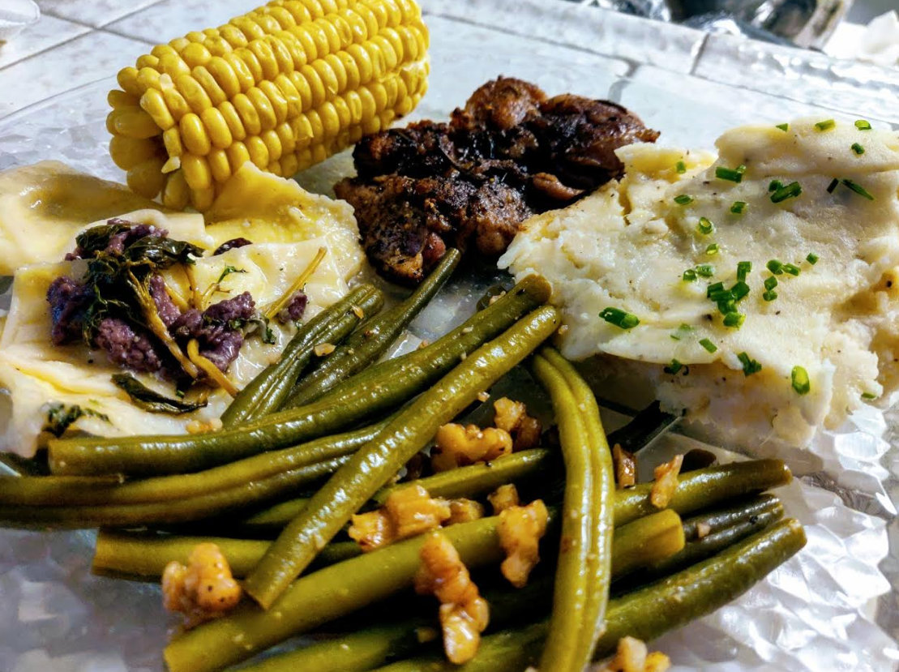
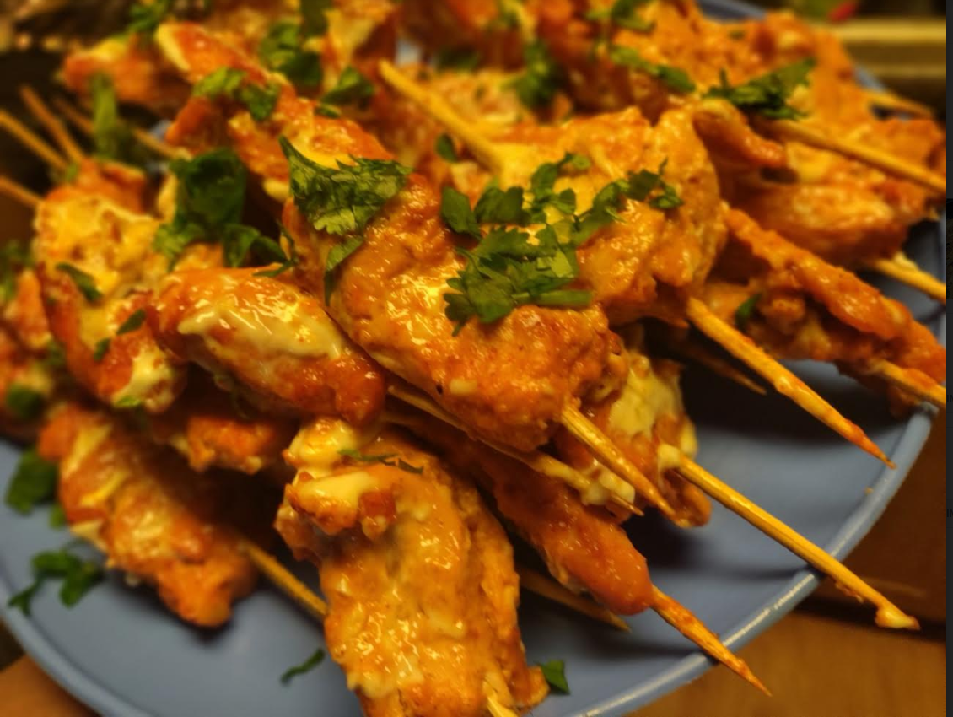
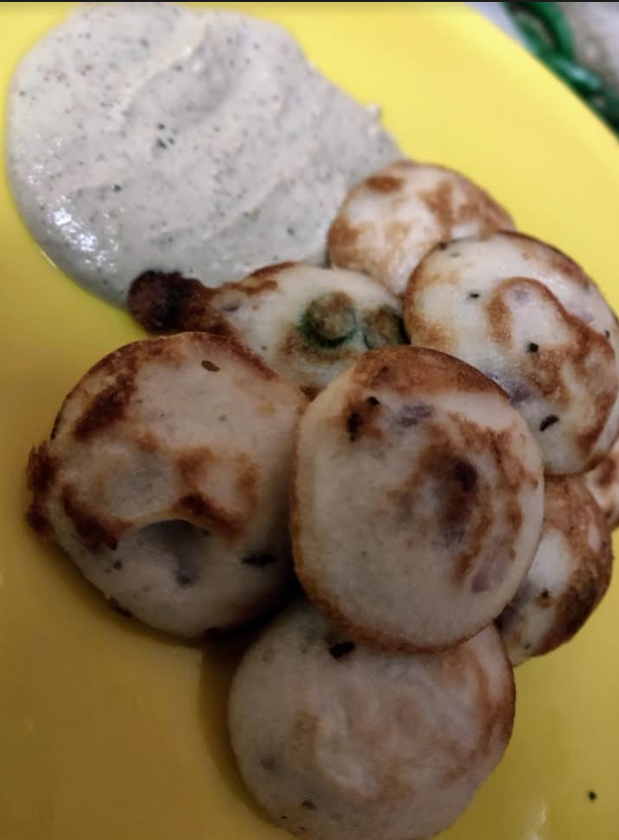
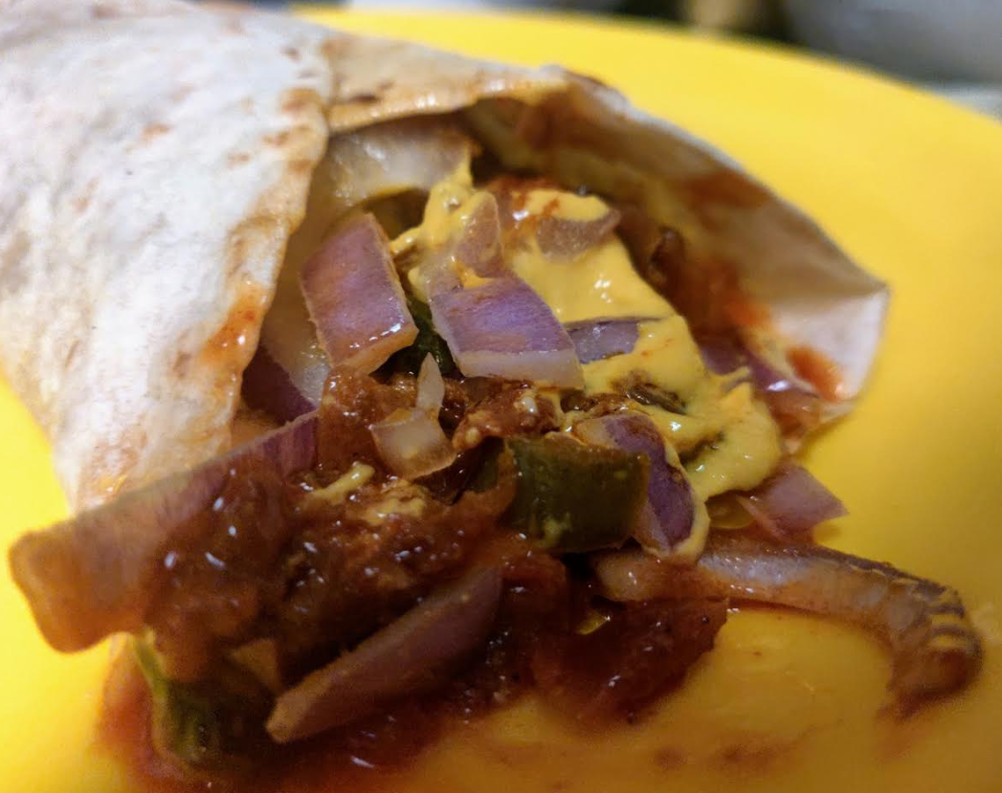
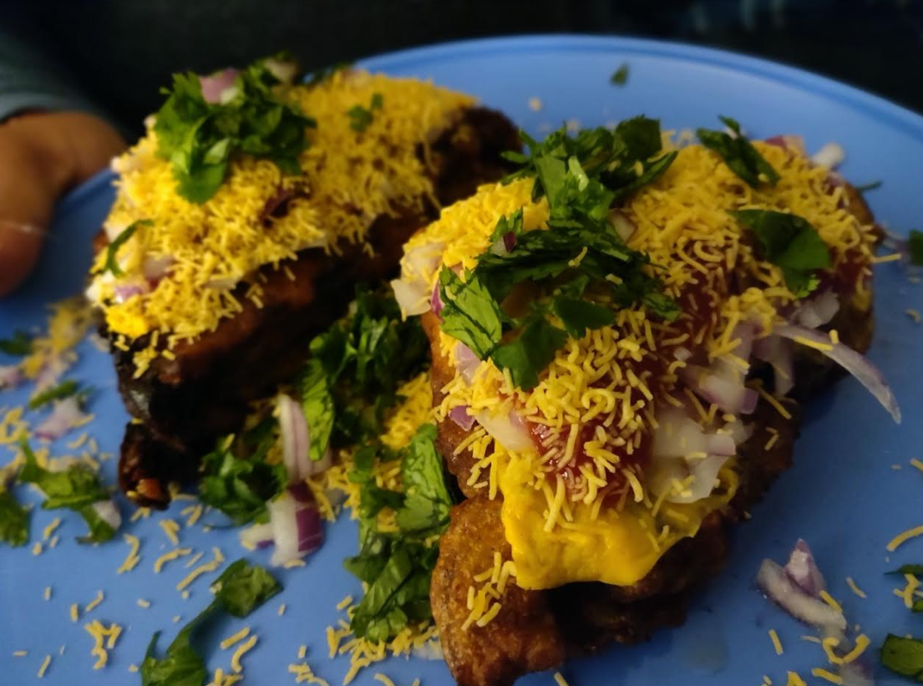
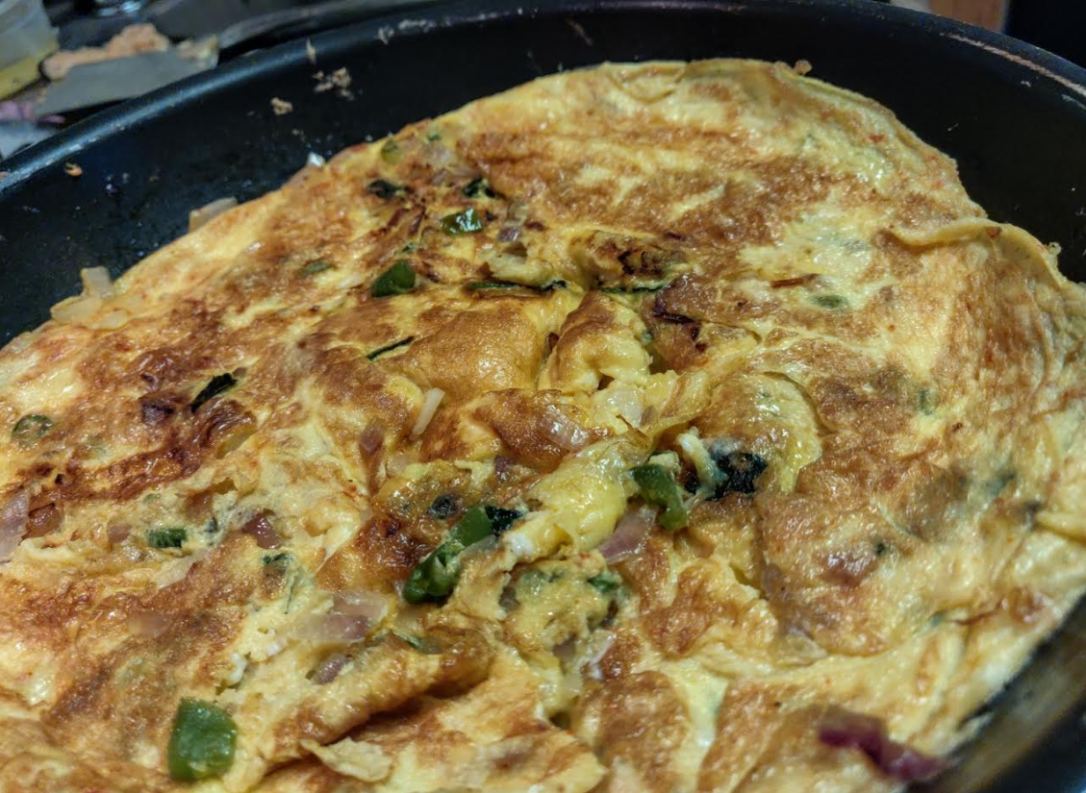
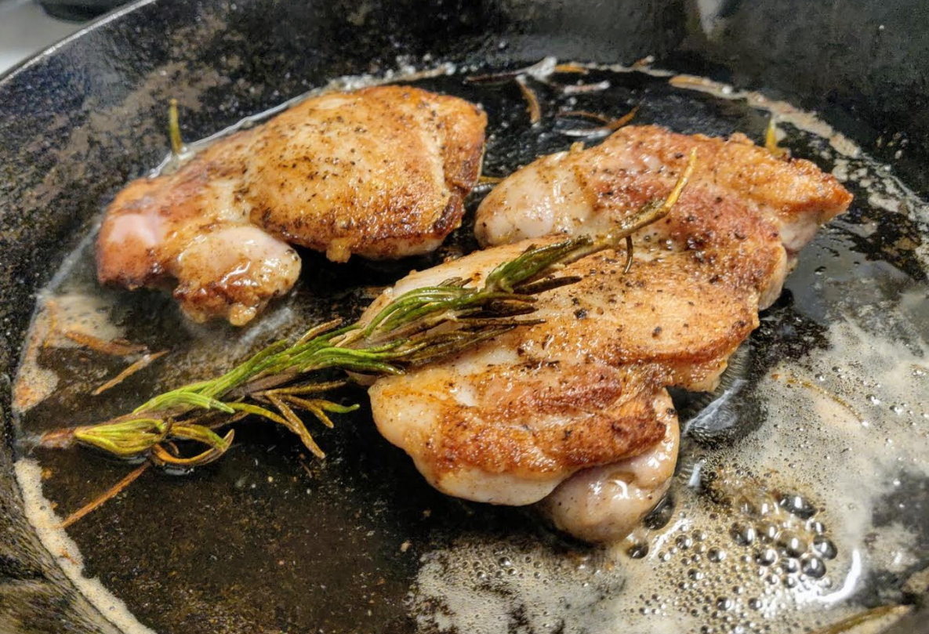
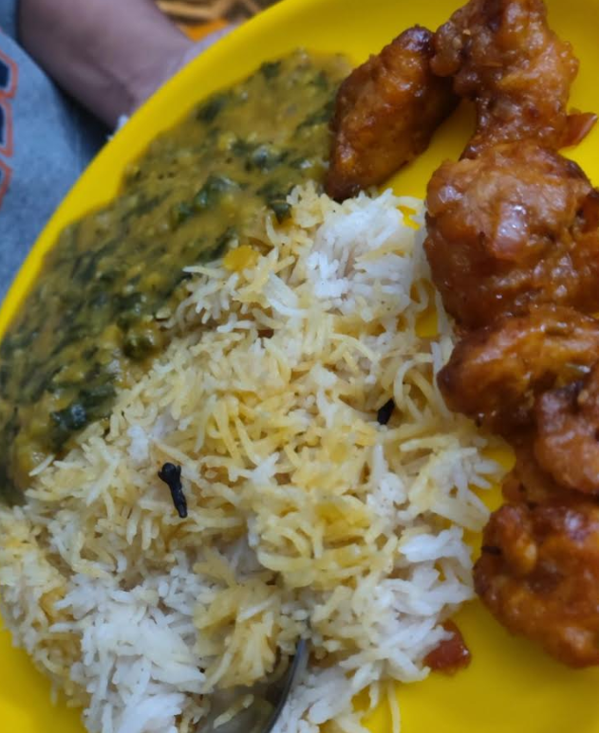
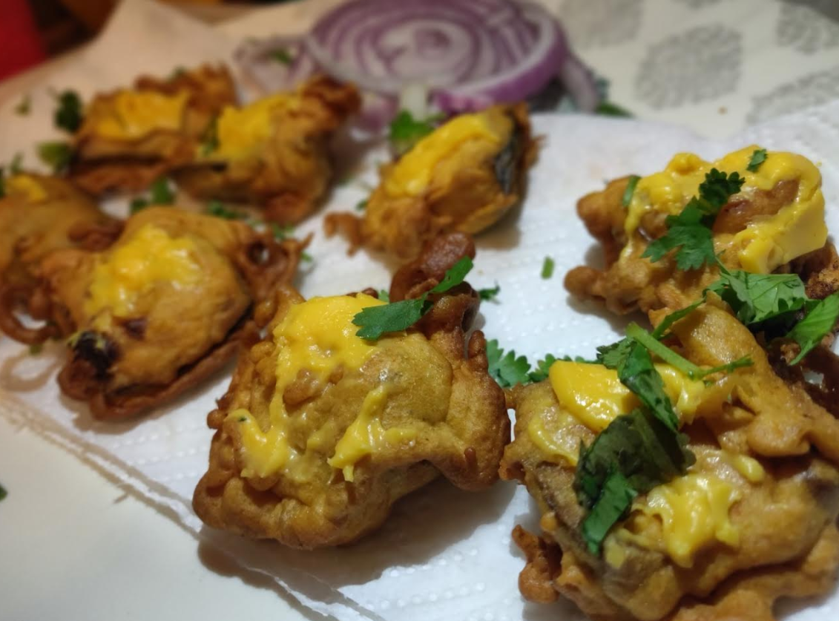
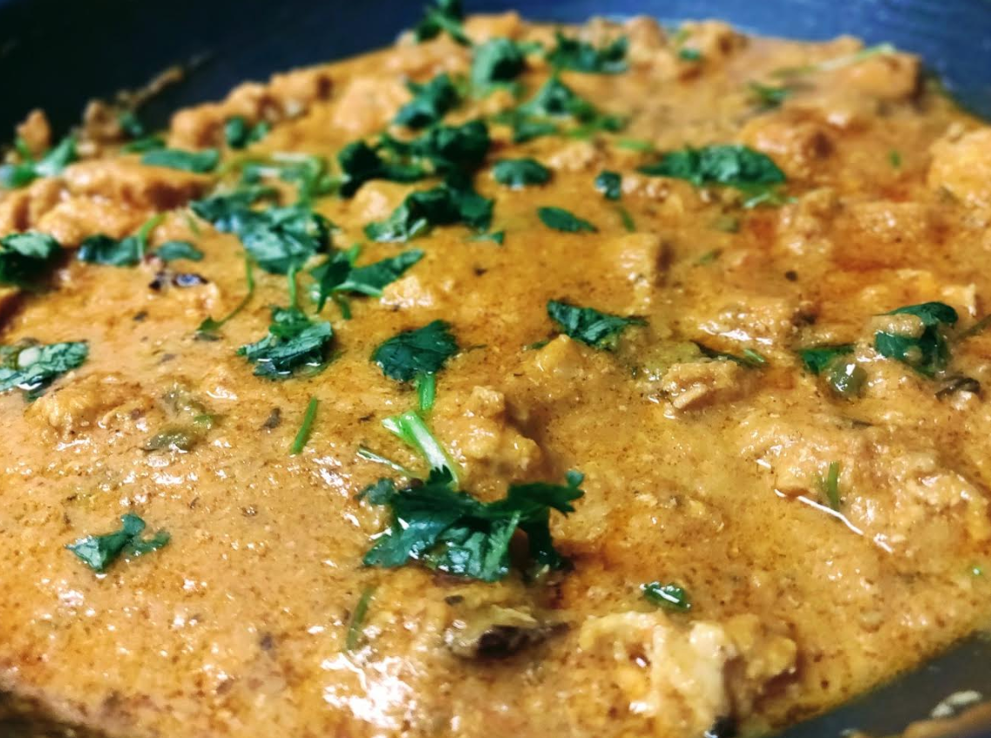
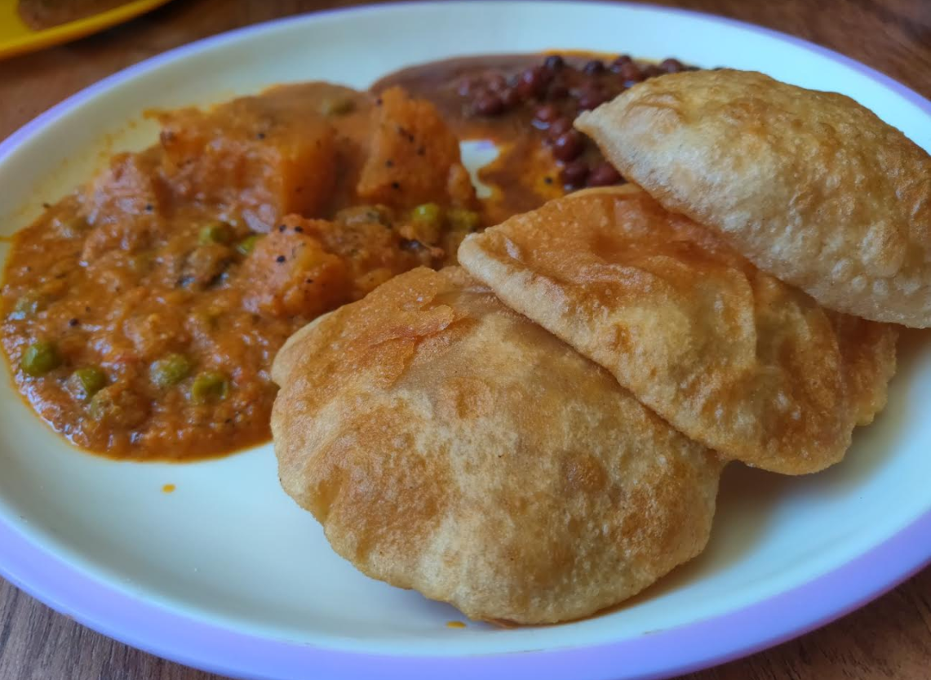
My motivation
Passion for Cooking

Slide 4
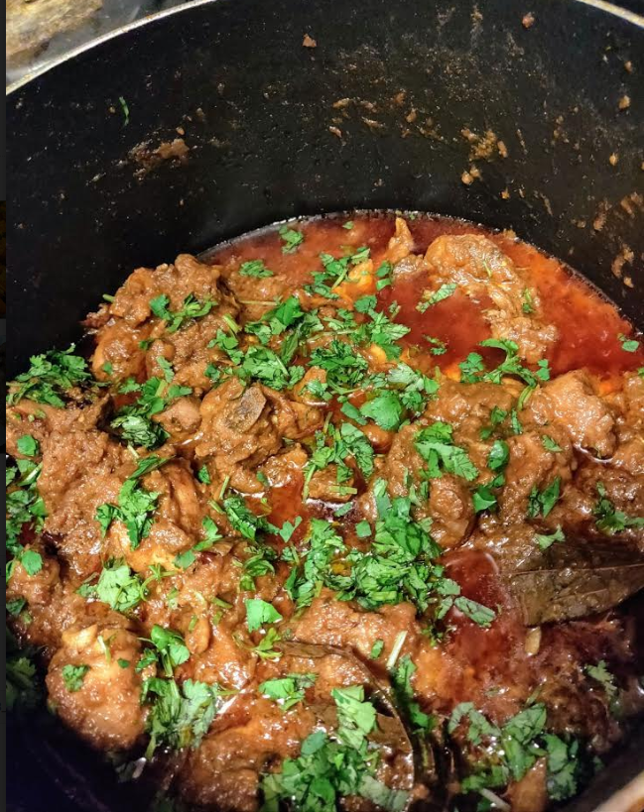
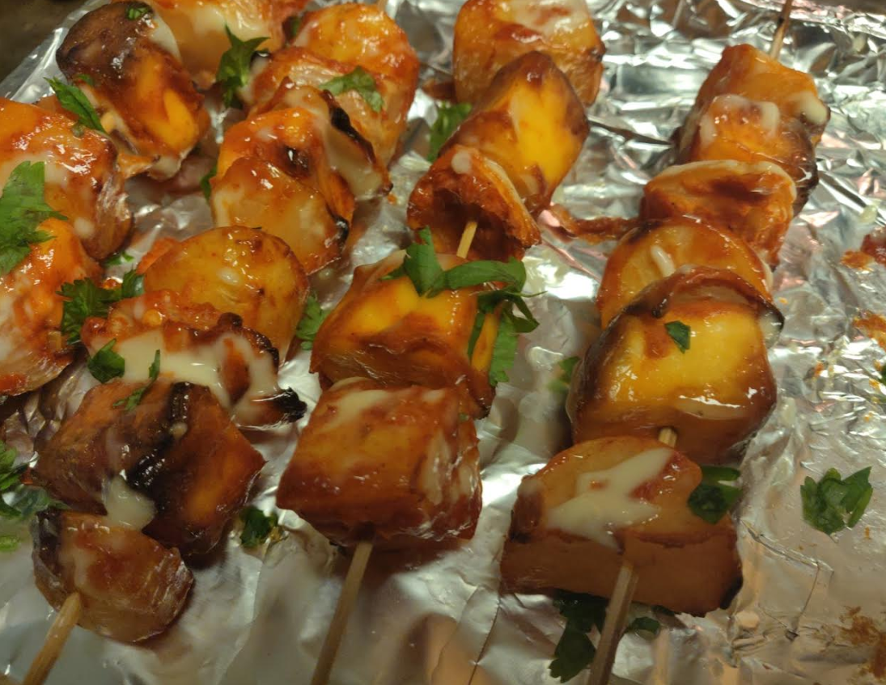
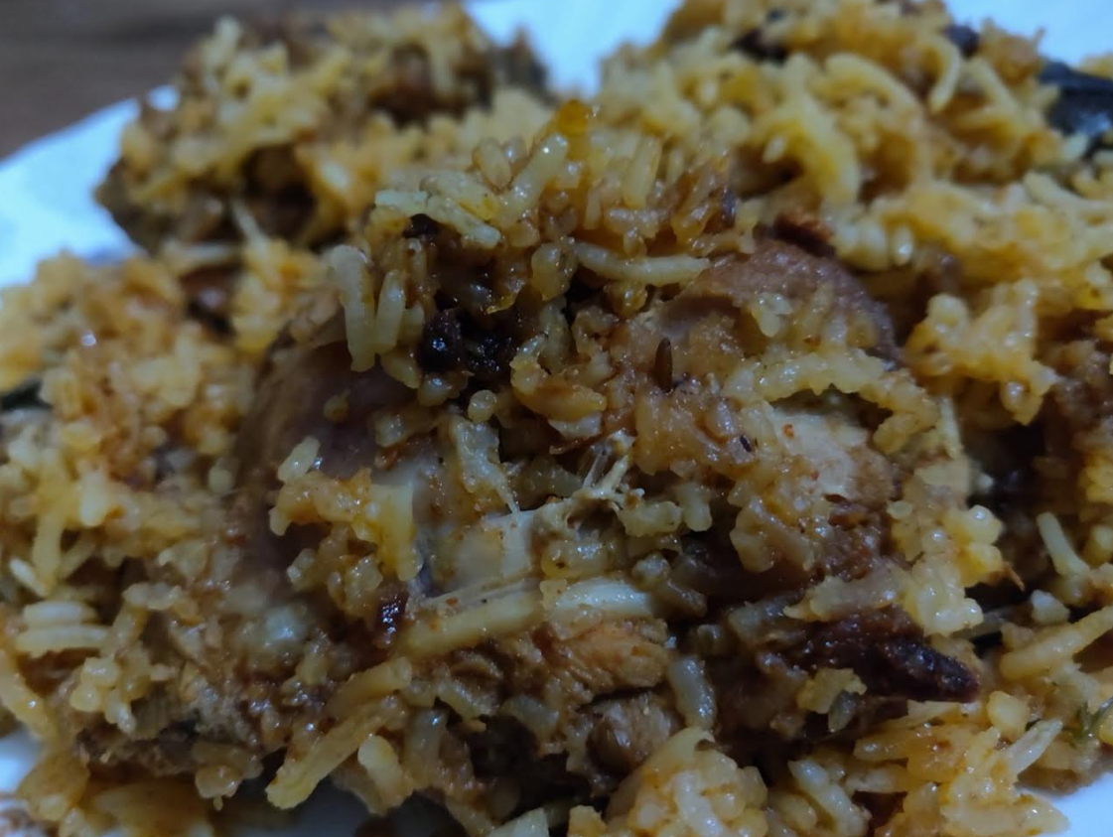

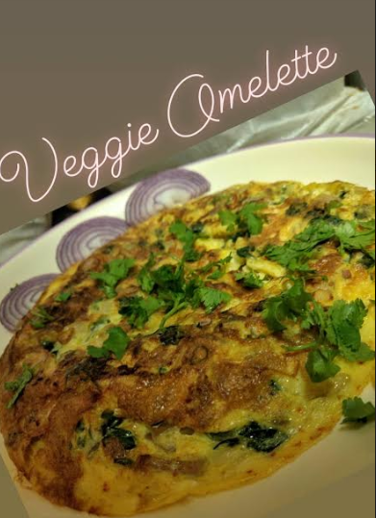
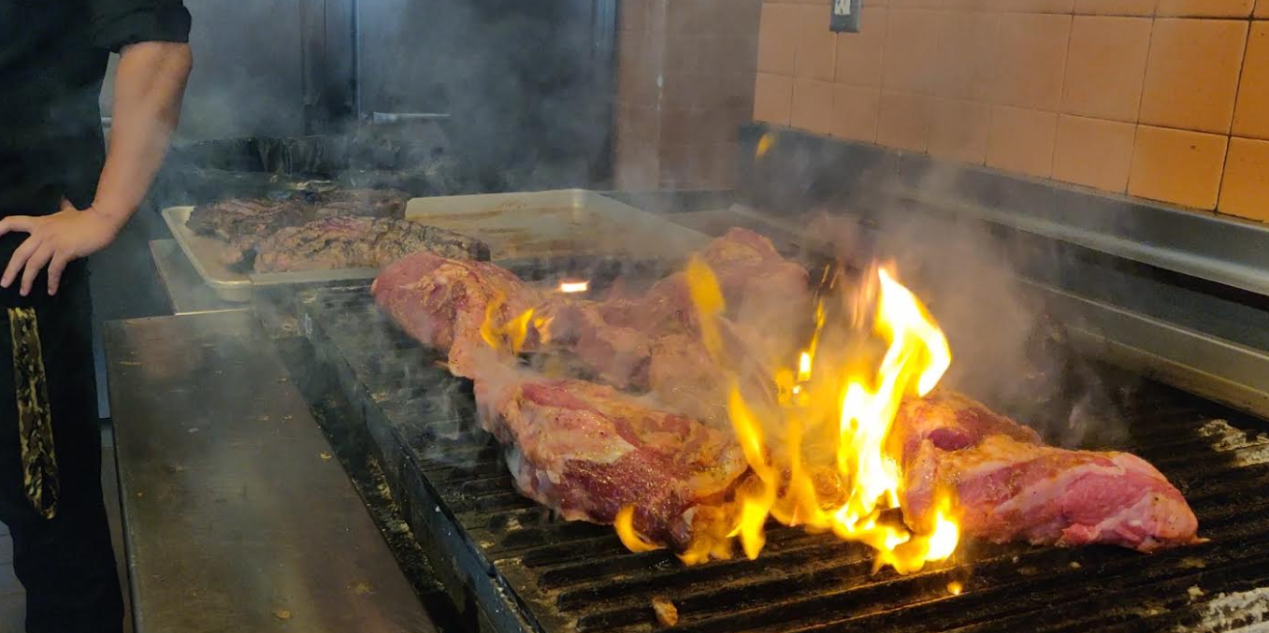
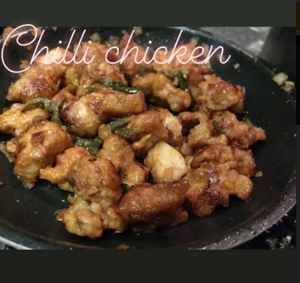
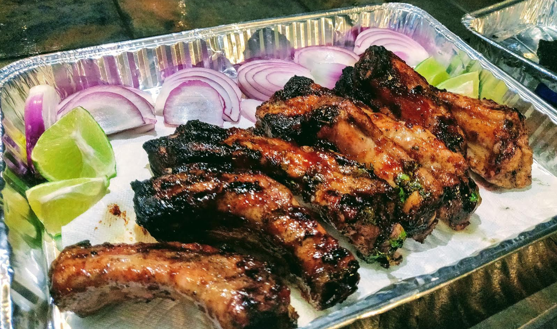
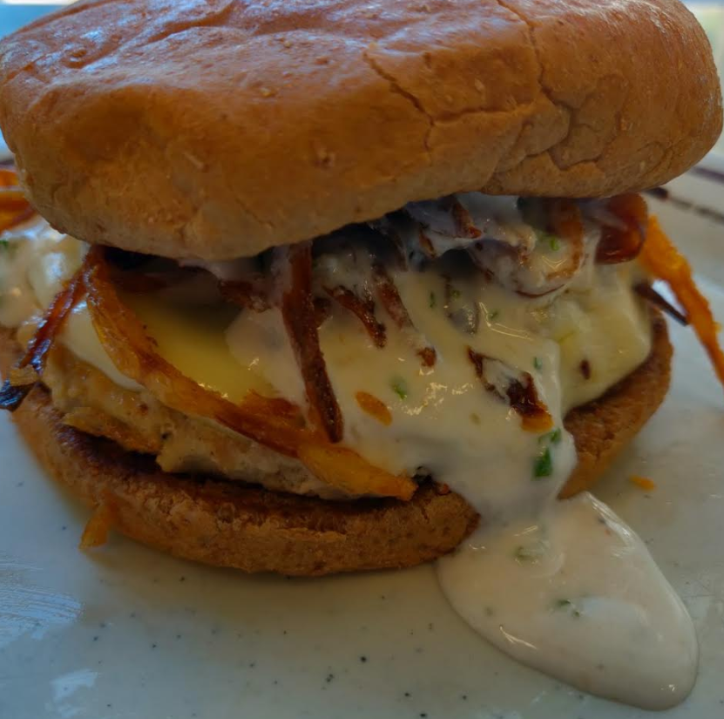
My motivation

Slide 5
Project Description

Slide 6
Background
Good and tasty food will always impress people which will make them talk about it
Customers = authentic opinions = trustworthy
Online community is one of the largest opinion resources

Slide 7
Problem & Solution
Hundreds of restaurants comeup with their own theme and food menu every now and then, so ending up in a good restaurant based on our preference is a challenging task.
Menu seem interesting, but can turn down customers when they don’t taste good.
Food allergy is a major concern in USA and customers can warn about them prior-ly if they have bad experiences.
Online reviews can be used to analyze the restaurant where customers express their opinions based on their experience.

Slide 8
Description
Sentiment Analysis is a process where we can classify and identify several feelings, opinions and classify them based on raw opinionated data, in which we identify the attitude of a person towards a product and, the basic idea is to mainly find the bias or view and classify them accordingly into positive view , negative view or not biased (Neutral).
It is an application of natural language processing. also sometimes known as opinion mining or emotion extraction. Text mining is a very famous research field of Sentiment analysis.

Slide 9
System Design Methodologies

Slide 10
System Design: Software/Libraries
Language: Python 3.7
Database: MongoDB
Flask Framework, HTML & CSS
Libraries:
json - Support .json
pandas – easy to use data manipulation and analysis library from Python
numpy – Mathematical functions, multi-dimensional arrays and matrices
nltk - Natural Language Processing
sklearn - Machine learning and statistical algorithms and computation
Matplotlib- Python 2D plotting library
Seaborn- Statistical data visualization
Pymongo- for connecting mongodb server

Slide 11
System Design: Functional aspects
The system will have dropdown menu with 10 food joint names.
The system shall let the user select the name from dropdown menu and submit it for further analysis.
The system shall display the Sentiment Analysis of the restaurants with respective graphs and statistics
The system shall display the confusion matrix for each food joints.
The system will have another text area where user can add random restaurant reviews and it will predict if it is a positive text or negative text.

Slide 12
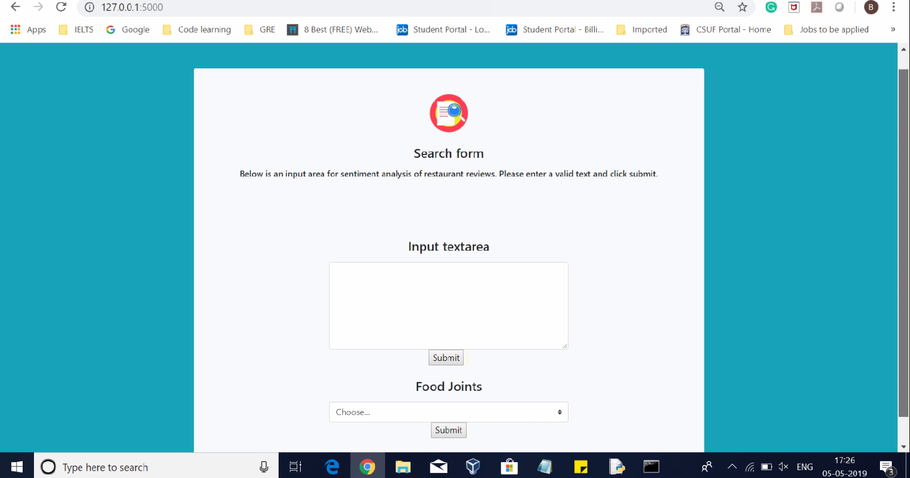
Front end

Slide 13
System Design: Data Collection
Data Collection:
Yelp Data set in json format downloaded from Kaggle. Total size of dataset 5 GB.
We seperated data for top 10 restaurants from main data set starting from year 2016 till 2018
Burger King
McDonald’s
Starbucks
Chipotle Mexican Grill
Nacho Daddy
Papa John’s Pizza
Subway
Taco Bell
The Cheesecake Factory
Wendy’s
Total rows in dataset nearly 20000 and using Mongodb for processing.

Slide 14
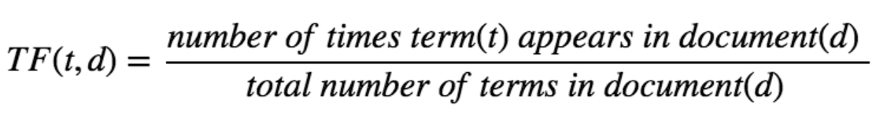
Data preprocessing and Algorithms
Text cleaning:
URL removal, Punctuation removal, special character removal
Stop word removal(Pronouns (it, she/he), articles (the, a, an), prepositions (besides, in, near) )
Feature selection using TF-IDF(Term frequency-inverse document frequency).
TF-IDF is a very common algorithm to transform text into a meaningful representation of numbers.
Sentiment analysis algorithms used in analysis.
Naive Bayes(NB)
Multilayer Perceptron(ANN based)
Support Vector Machine(SVM)

Slide 15
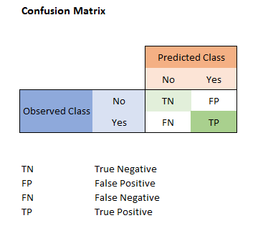
Model Validation
Holdout Method | Confusion Matrix
Hold-out is when you split up your dataset into a ‘train’ and ‘test’ set. The training set is what the model is trained on, and the test set is used to see how well that model performs on unseen data. We have used here 80% data for Training and 20% for Test. | A confusion matrix is a table that is often used to describe the performance of a classification model. A specific table layout that allows visualization of the performance of an algorithm, typically a supervised learning one.

Slide 16
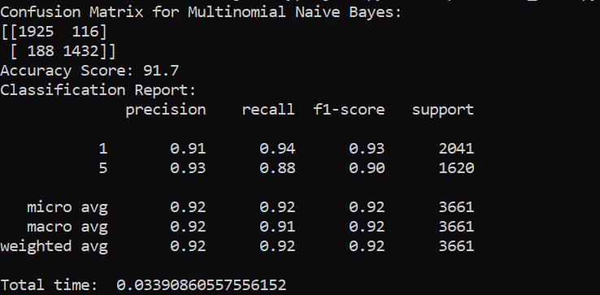
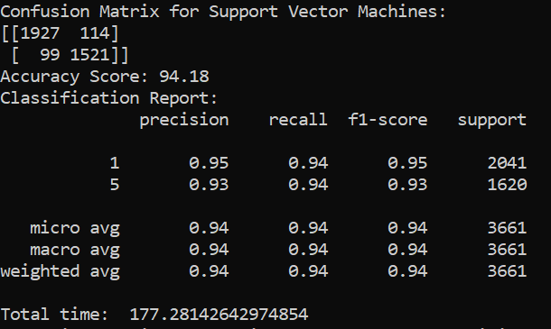
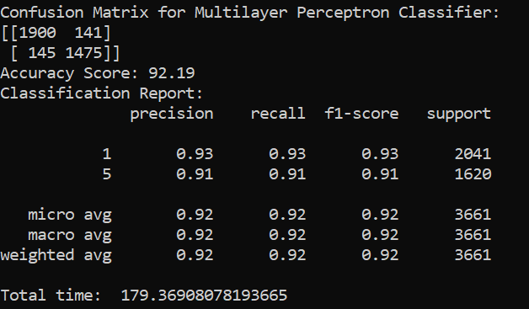
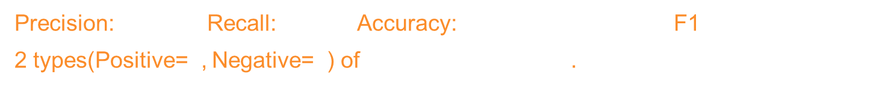
Comparison: Models
Precision: $\frac{tp}{tp+fp}$ Recall: $\frac{tp}{tp+fn}$ Accuracy: $\frac{tp+tn}{tp+tn+fp+fn(Total set)}$ F1=2. $\frac{Precision∗Recall}{Precision+Recall}$
2 types(Positive=5, Negative=1) of emotion comparison.
Naive Bayes | Support Vector Machine | Multilayer perceptron

Slide 17
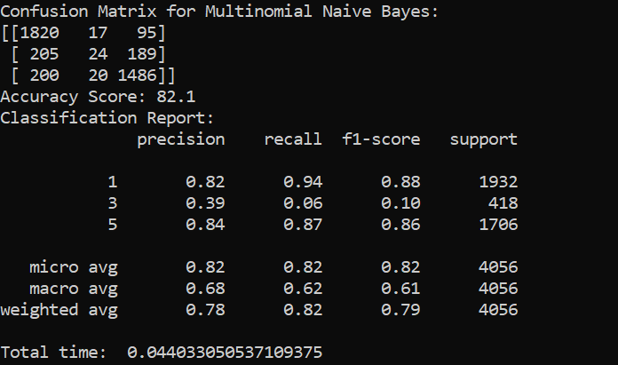
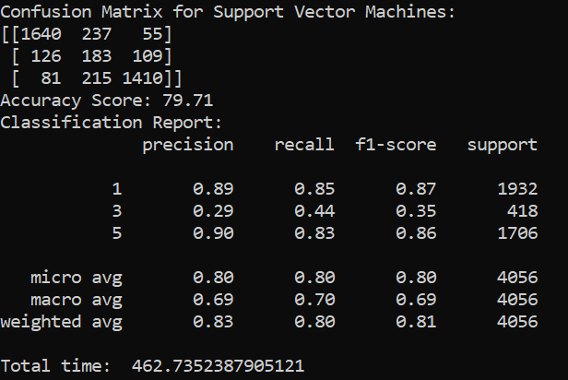
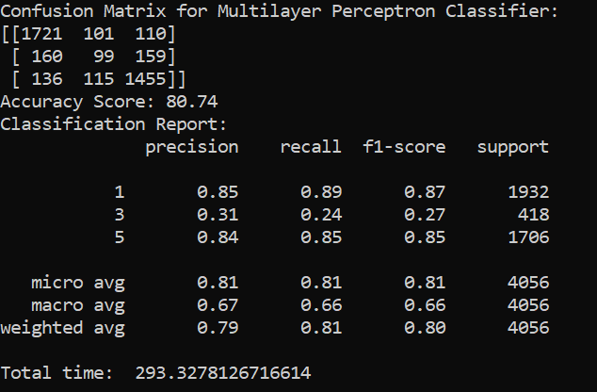
Comparison: Models
3 types(Positive=5, Neutral=3, Negative=1) of emotion comparison.
Naive Bayes | Support Vector Machine | Multilayer perceptron

Slide 18
Demo

Slide 19
Conclusion
SVM and MLP more accurate than Naïve Bayes.
MLP and SVM performs with nearly similar accuracy. But SVM is much Faster and accurate than MLP for our dataset.
Restaurants can make use of the model, to analyse their business and make improvements.

Slide 20
Significance
Sentiment analysis is extremely useful in social media monitoring as it allows us to gain an overview of the wider public opinion behind certain topics.
Understanding contextual analysis and tone of reviews.
Customers can analyze a restaurant before they step in.

Slide 21
Implications and future scope
Model will build the pressure on restaurants to serve quality food based on customer’s expectations.
Using Hybrid model for validation of data.
Implementing Sarcasm detection or Neutral emotion detection more accurately.
Total dataset is 5GB. So, implementing the algorithms for whole 5GB Dataset.
Will require more computing capacity to process this huge data.

Slide 22
Thank You!
GIRISH KUMAR RAMACHANDRA 89girishkumar@csu.Fullerton.edu
888253630

